Slide 1
Internships 101
Peter Frantz – Recruiter – Federal Highway Administration
A Presentation for the 2024 Maryland FBLA State Leadership Conference

Slide 2
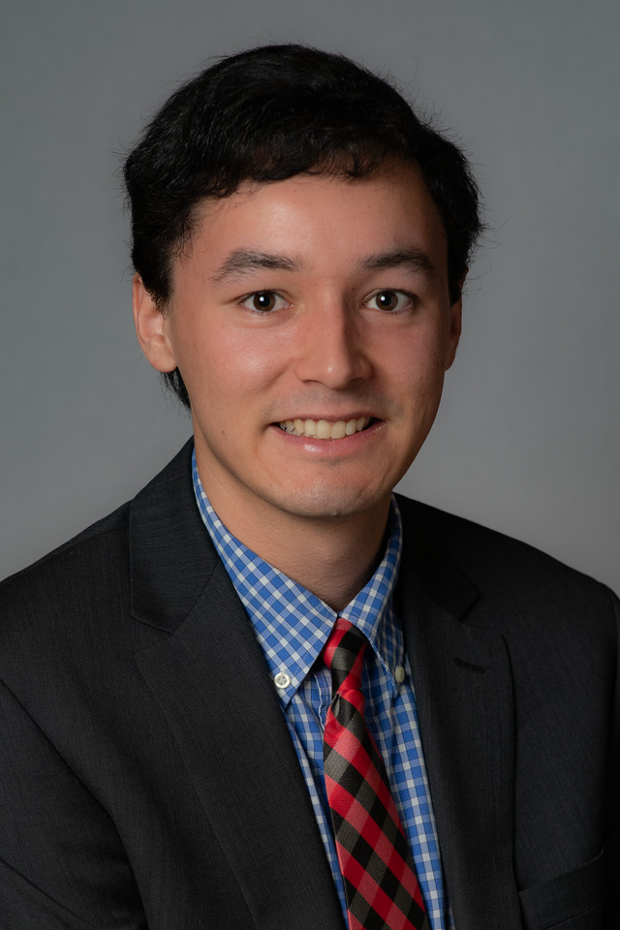
Internships 101 Introductions
My name is…I traveled from…
Peter Frantz…Washington, DC
I work for…
The Federal Highway Administration (FHWA)
I went to…
The University of Maryland

Slide 3
Internships 101 Agenda for Today’s Presentation
Introductory poll question
Peter’s story, from high school to FHWA, and beyond!
The Federal Highway Administration – who we are, what we do, and where we work
A recently-completed bridge project over the Potomac River

Slide 7
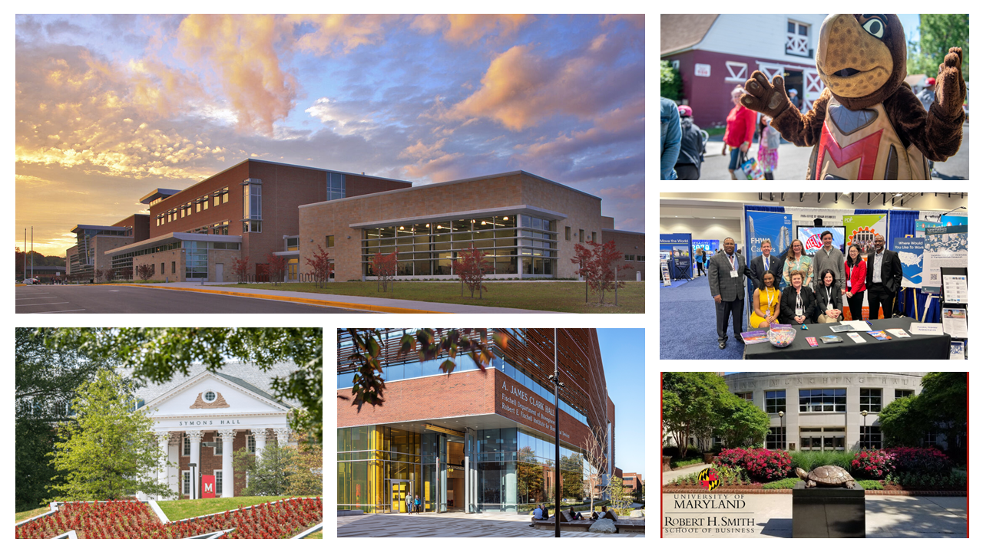

Slide 11
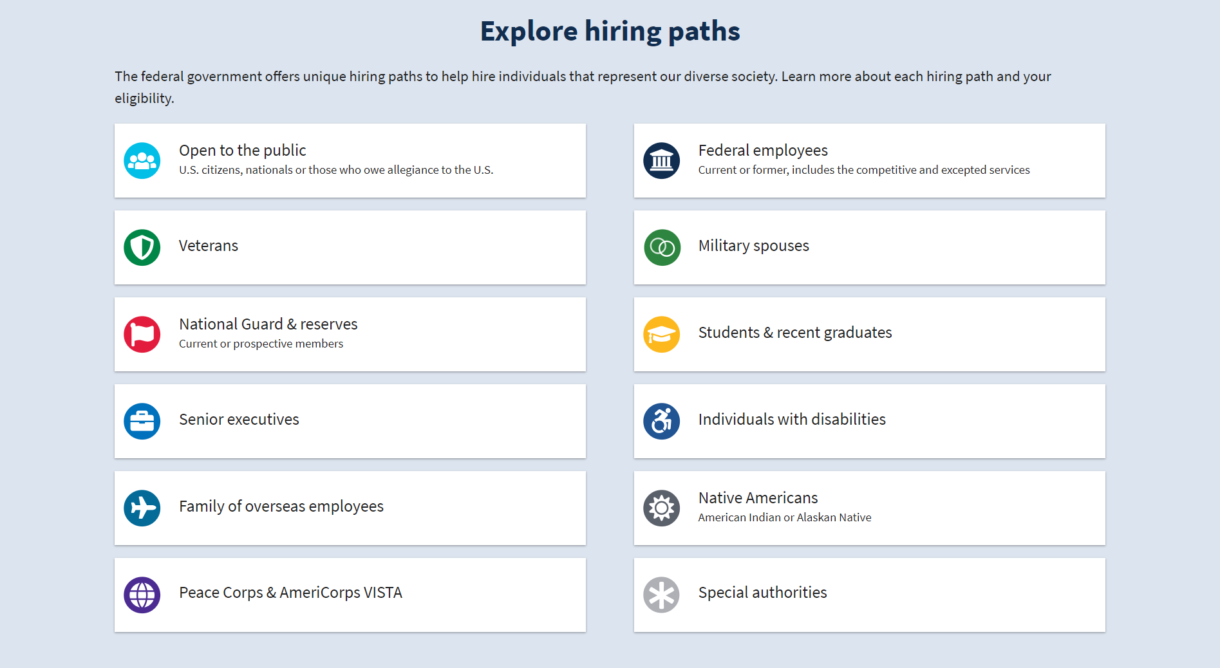

Slide 12
Internships 101 Key Sites and Links to Keep in Mind!
Current job and internship opportunities at FHWA:
www.tinyurl.com/FHWACO
Learn more about FHWA and our internship, transportation fellowship, and recent graduate programs:
www.highways.dot.gov/careers

Slide 16
Internships 101 Let’s take a journey to…
The Arlington Memorial Bridge…
…across the Potomac River

Slide 17
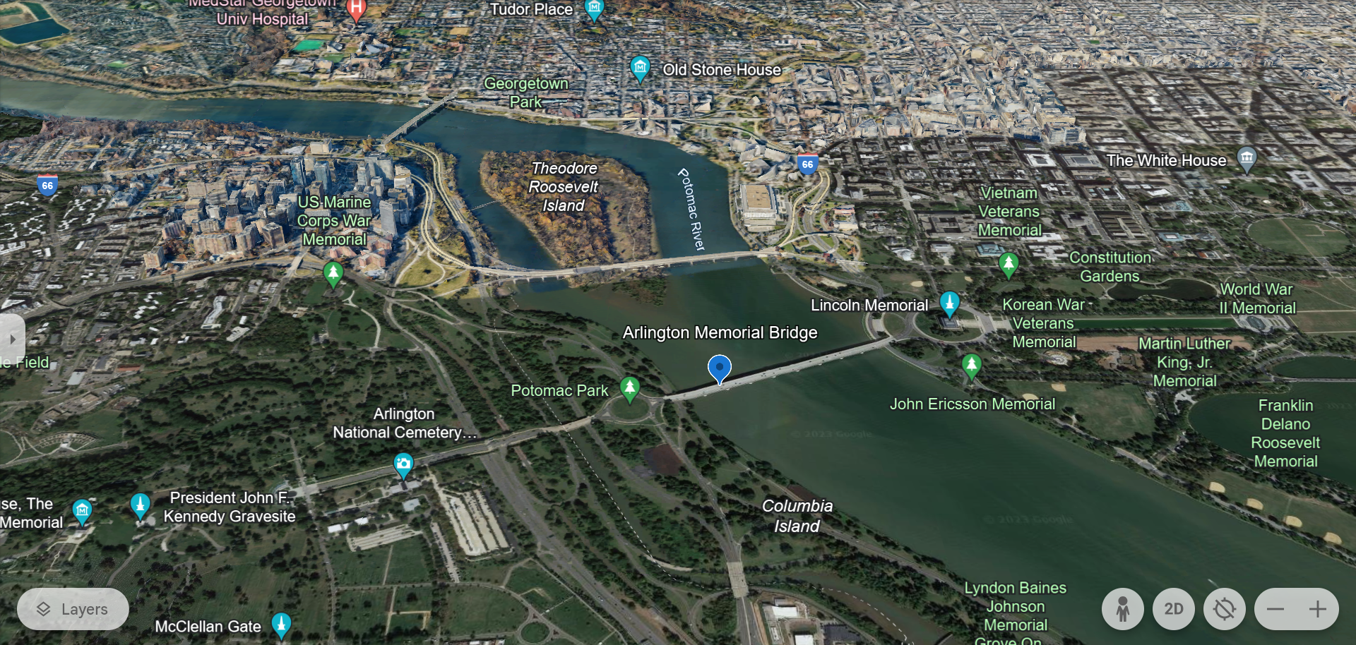

Slide 20
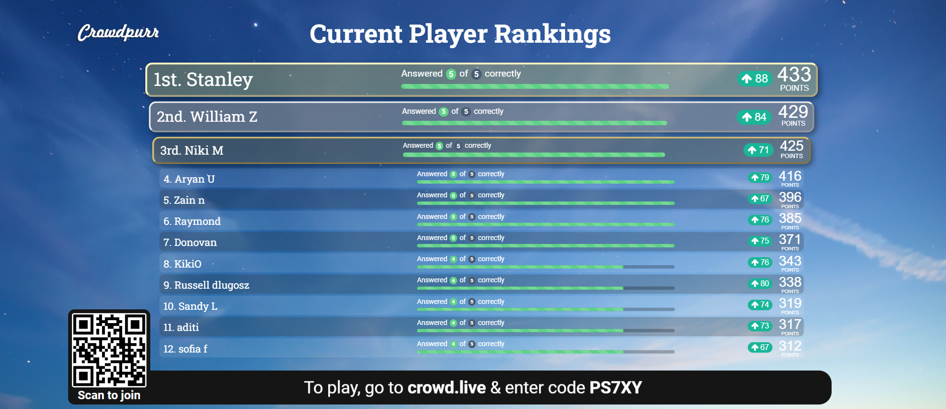

Slide 22
Internships 101 Questions? Questions? Questions?

